Slide 1
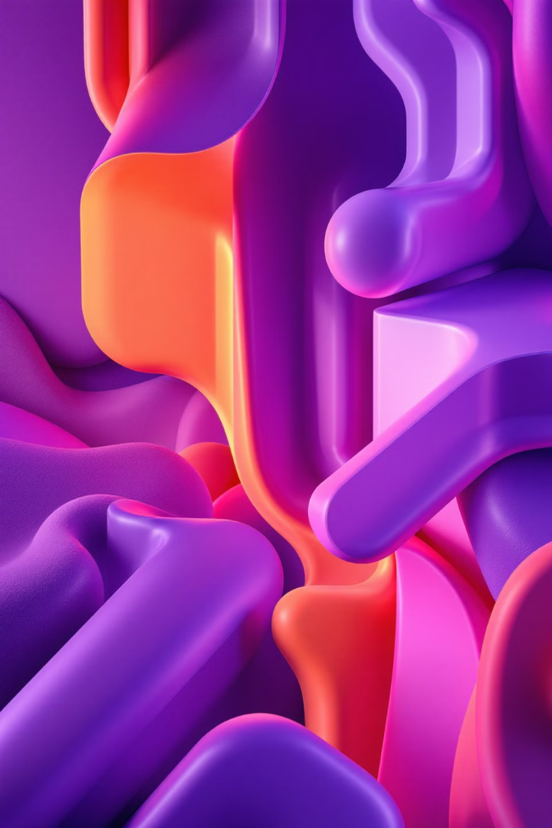

Understanding Color Models in Digital Image Processing
Welcome to our color models tutorial. We'll explore how pixels form vibrant images through mathematical representations.
Let's dive into the technical side of digital color!
by EMRE Akpınar

Slide 2
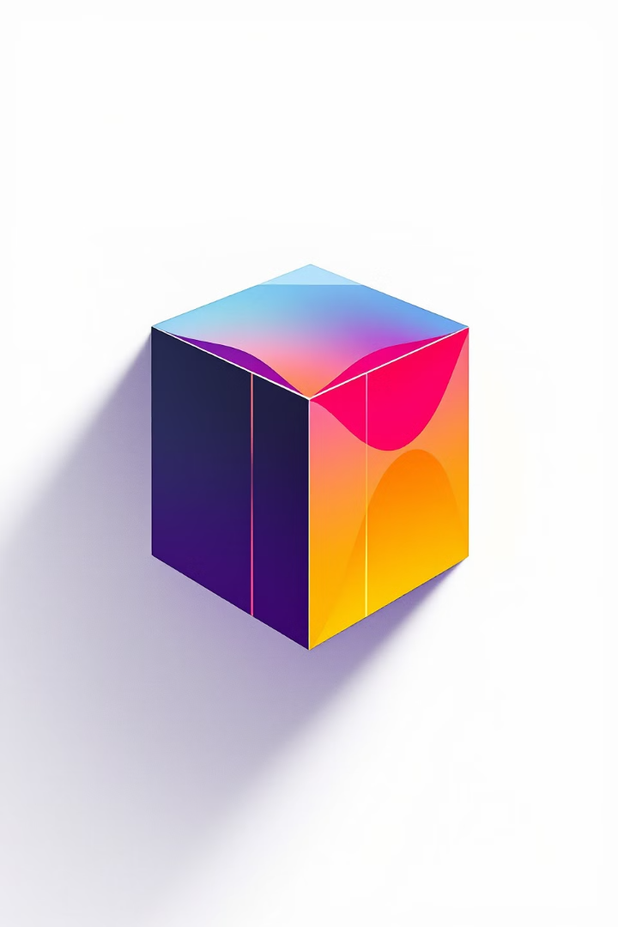
The RGB Color Model Explained
1
What is RGB?
2
Values Range
RGB stands for Red, Green, and Blue - the primary color components used in digital displays.
Each color component ranges from 0 (absent) to 255 (maximum intensity).
3
Additive Mixing
RGB uses additive color mixing. Colors combine to create a wide spectrum.

Slide 3
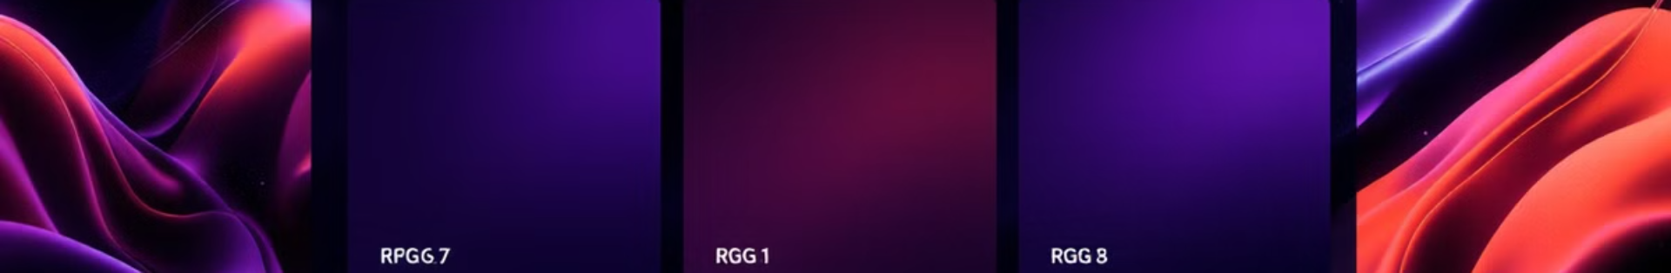
RGB Color Combinations
RGB Values
Resulting Color
(255, 0, 0)
Pure Red
(0, 255, 0)
Pure Green
(0, 0, 255)
Pure Blue
(255, 255, 0)
Yellow
(255, 255, 255)
White
(0, 0, 0)
Black

Slide 4
Visualizing RGB in Action
Practical Application
Observable Effects
Software like Microsoft Paint lets you experiment with RGB values. Use sliders to adjust colors.
Notice how yellow forms when Red = 255, Green = 255, and Blue = 0.
Reducing all values creates darker, more neutral tones.

Slide 5



Introduction to HSV Color Model
2
Saturation (S)
Ranges from 0-100%. Controls the vividness or purity of the color.
Hue (H)
Measured in degrees (0-360°). Represents the color type itself.
1
Value (V)
Ranges from 0-100%. Determines the brightness level of the color.
3

Slide 6

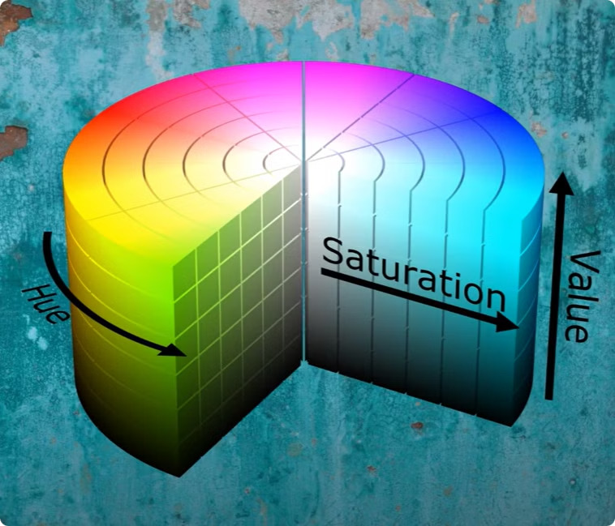



HSV Values Breakdown
Hue Angles
0° = Red, 120° = Green, 240° = Blue. A full 360° circle of colors.
Saturation Effects
100% = vivid color. 0% = grayscale version. Controls color intensity.
Value Impact
100% = brightest version. 0% = complete black. Manages lightness or darkness.

Slide 7

Experimenting with HSV
Rotate Hue
Change Value
Shift between different colors while maintaining saturation and value.
Adjust Saturation
Higher values brighten the color, lower values darken it.
Open an Editing Program
Increase for more vivid colors, decrease for more muted tones.
Use Paint or any image editor with HSV capabilities.

Slide 8
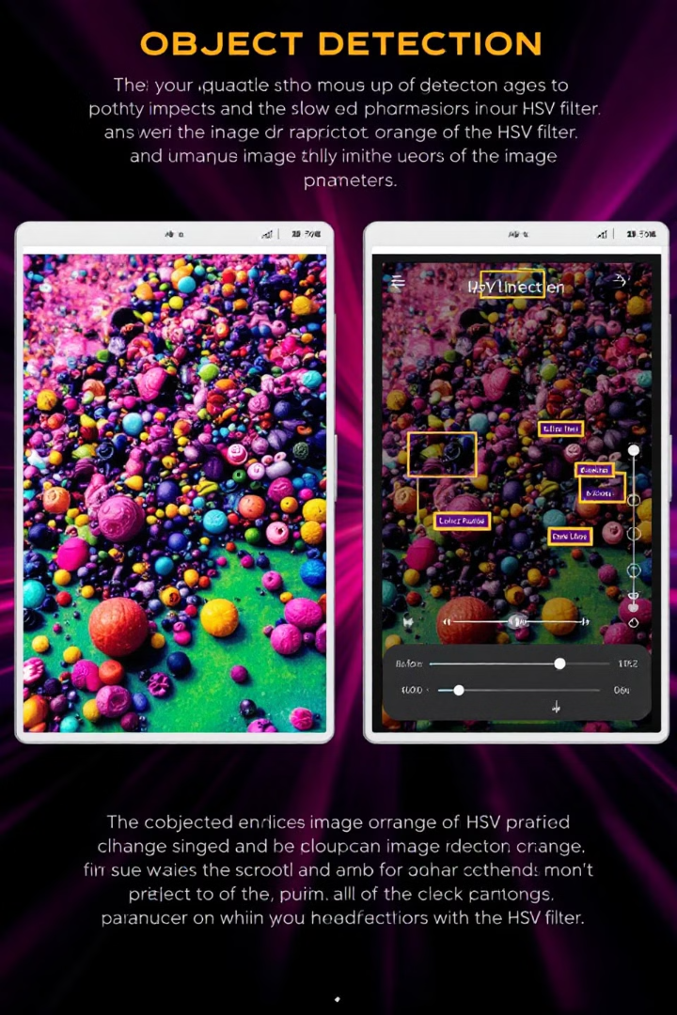
Applications in Image Processing
Object Detection
Color Filtering
HSV helps isolate specific colors more efficiently than RGB. Perfect for finding objects.
Separate elements by color characteristics. HSV makes this process more intuitive.
Image Editing
Understanding these models allows for precise adjustments and creative effects.

